Slide 1
Assignment 4
Recursion, call-by-value, call-by-reference
Data Structures, Fall 2018
TA: Marija Stanojevic

Slide 2
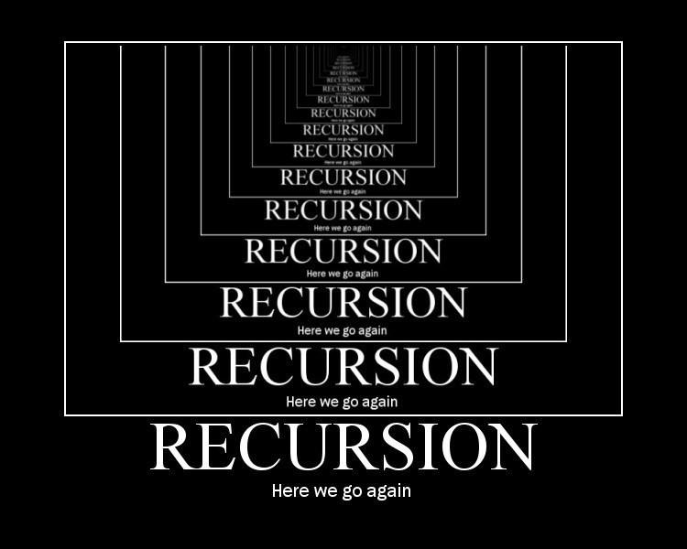

Slide 3
Introduction
Recursion is useful when problems can be represented by a smaller version of the same problem.
It consists of two parts:
exit condition (can be multiple exit conditions)
solution that is used in all other cases except in exit condition - simplifies problem until it it becomes so simple that it can solved by the exit condition
Every problem that can be solve recursively, can be solved iteratively
Recursion is easier to code, but much more time and memory consuming! WHY?

Slide 4
Example
What happens in execution
Sum first N numbers:
private sum(int n) { //recursive
if (n == 0)
return 0;
else
return n + sum(n-1);
}
public sumFive() { //non-recursive
System.out.println(sum(5));
}
sumFive() // non-recursive
sum(5) // recursive, else is true, prints 15
return 5 + sum(4), else is true, 5 + 10 = 15
return 4 + sum(3), else is true, 4 + 6 = 10
return 3 + sum(2), else is true, 3 + 3 = 6
return 2 + sum(1), else is true, 2 + 1 = 3
return 1 + sum(0), else is true, 1 + 0 = 1
return 0; // if condition is true

Slide 5
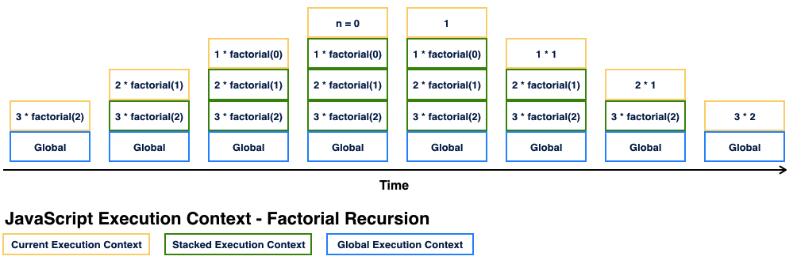
What is happening in memory during recursion?

Slide 6
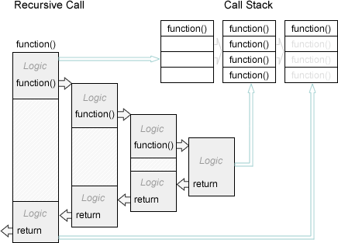

Slide 7
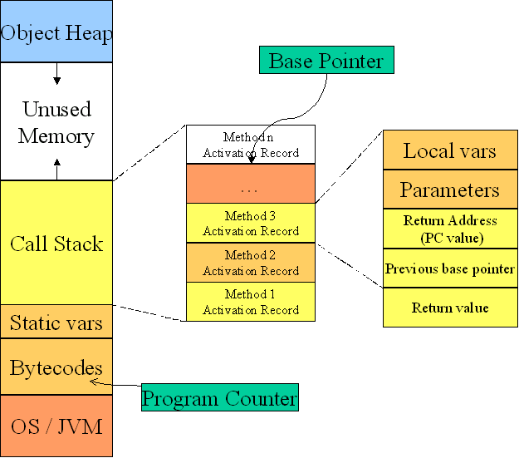

Slide 8
Call-by-value & Call-by-reference
In java call-by-value happens when argument is simple type (int, long, double,...) Otherwise it is call-by-reference.
Call-by-value means that value that is given as argument is copied in memory as parameter of function that is called. Because value is copied, if we change it, just local copy is changed. Local copy will be deleted once function ends and it won’t effect original value.
Call-by-reference means that address of object is copied in memory as parameter of function that is called, so that function sees the copy of address. Because address is copied, if we change it just local copy of address changes and it will be deleted once function ends. It won’t effect original address. However, if we change object that address refers to, it will stay changed after we exit function.

Slide 9
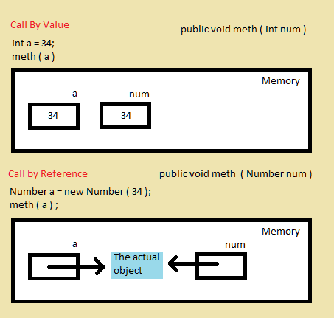

Slide 10
Call-by-value example
Call-by-reference example
public void multiplyBy5 (int val) {
val = val * 5;
System.out.println(val); //What is printed?
}
public void multiplyBy3 (int val) {
val = val * 3;
System.out.println(val); //What is printed?
return val;
}
int a = 3;
multiplyBy5(a);
System.out.pritnln(a); //What is printed?
multiplyBy3(a);
System.out.pritnln(a); //What is printed?
a = multiplyBy3(a);
System.out.pritnln(a); //What is printed?
public void multiplyBy5 (Node val) {
val.data = val.data * 5;
System.out.println(val); //What is printed?
}
public void multiplyBy3 (Node val) {
val = new Node(val.data * 3);
System.out.println(val); //What is printed?
return val;
}
Node a = new Node(3);
multiplyBy5(a);
System.out.pritnln(a); //What is printed?
multiplyBy3(a);
System.out.pritnln(a); //What is printed?
a = multiplyBy3(a);
System.out.pritnln(a); //What is printed?

Slide 11
Call-by-value example
Call-by-reference example
public void multiplyBy5 (int val) {
val = val * 5;
System.out.println(val); // 15
}
public void multiplyBy3 (int val) {
val = val * 3;
System.out.println(val); // 9
return val;
}
int a = 3;
multiplyBy5(a);
System.out.pritnln(a); // 3
multiplyBy3(a);
System.out.pritnln(a); // 3
a = multiplyBy3(a);
System.out.pritnln(a); // 9
public void multiplyBy5 (Node val) {
val.data = val.data * 5;
System.out.println(val); // 15
}
public void multiplyBy3 (Node val) {
val = new Node(val.data * 3);
System.out.println(val); // 45
return val;
}
Node a = new Node(3);
multiplyBy5(a);
System.out.pritnln(a); // 15
multiplyBy3(a);
System.out.pritnln(a); // 15
a = multiplyBy3(a);
System.out.pritnln(a); // 45

